Slide 1

How do stock market trends impact Housing Price Index?

Slide 2
Abstract
This study aims to analyze and predict the seasonally not adjusted house pricing index using a comprehensive dataset of economic indicators spanning several years.
Employing Linear Regression, Random Forest, and Time Series Analysis, the research seeks to uncover linear and non-linear relationships, temporal dynamics, and future trends in housing price.
Evaluation metrics such as R-squared, Mean Squared Error will gauge model performance. The expected outcomes include insights into direct and complex interactions influencing pricing, as well as predictive models for strategic planning.
The significance of the research lies in its potential to guide policymakers, economists, and institutions in shaping effective economic strategies and policies for workforce development and planning.

Slide 3
Dataset Description
Stock Prices Data
Stock Open Price
Stock High Price
Stock Low Price
Stock Closing Price
Housing Price Data
Seasonally adjusted purchase index percent
Seasonally adjusted purchase index
Seasonally not adjusted purchase only index
Seasonally not adjusted purchase index percent
Volume
The dataset encompasses a comprehensive collection of quarterly data from the first quarter of 2000 through to the second quarter of 2023, detailing the S&P Global stock market indices alongside the house pricing rates for New York State

Slide 4

Exploratory Data Analysis

Slide 5
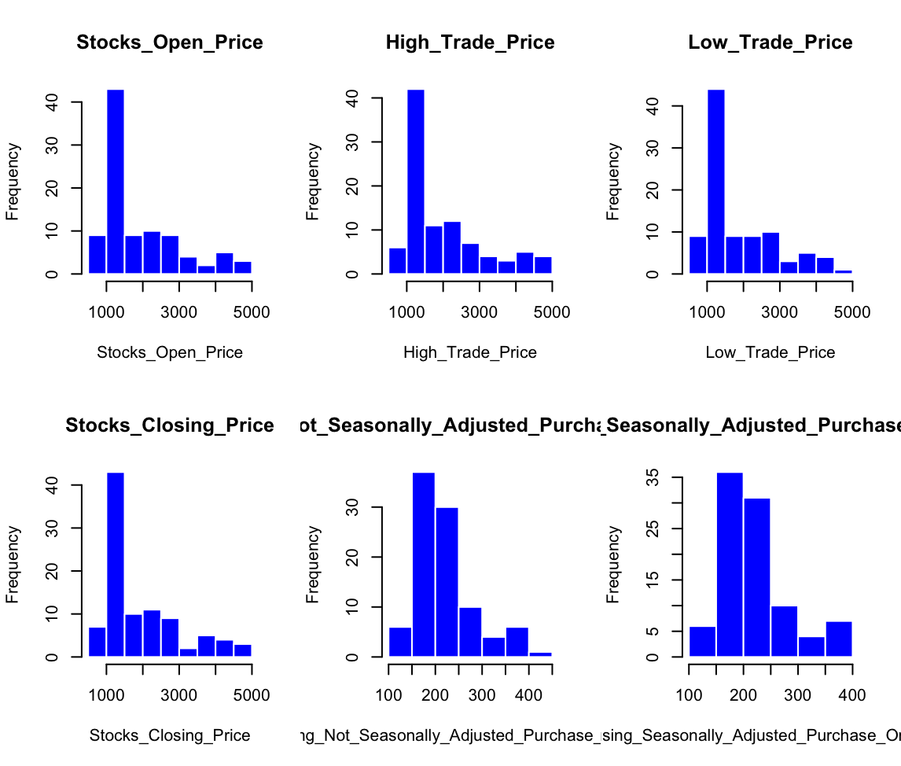
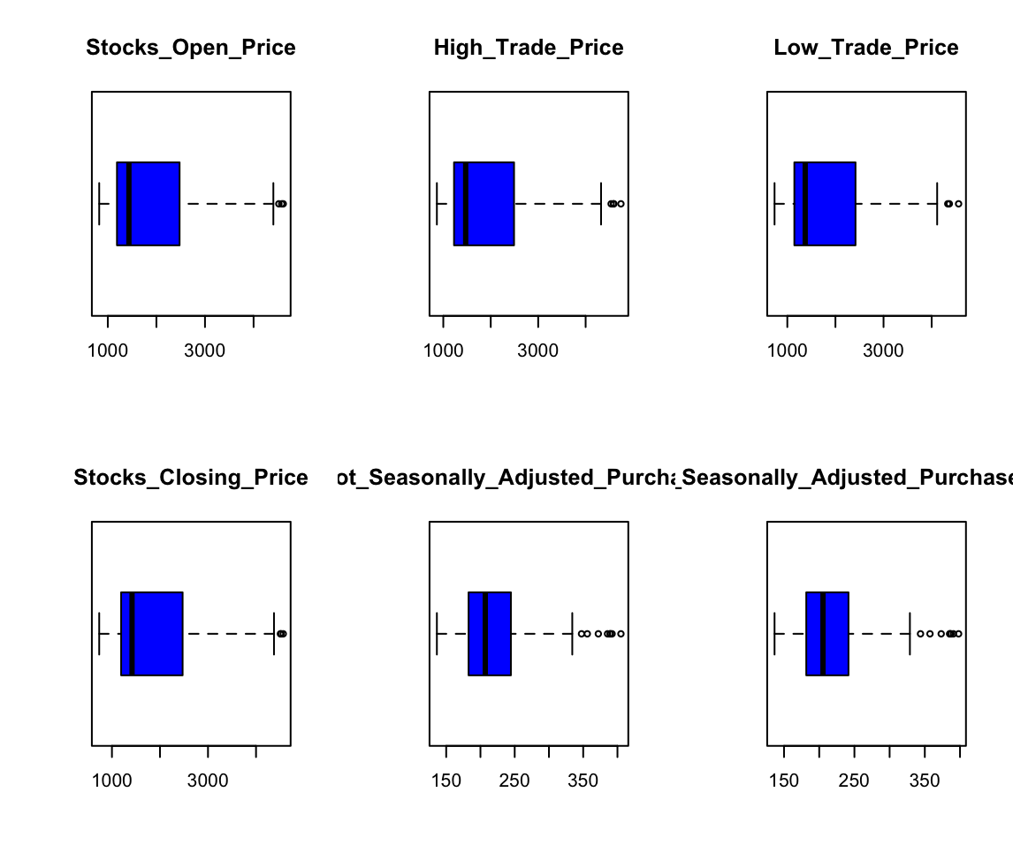
Histogram and Box plot:

Slide 6
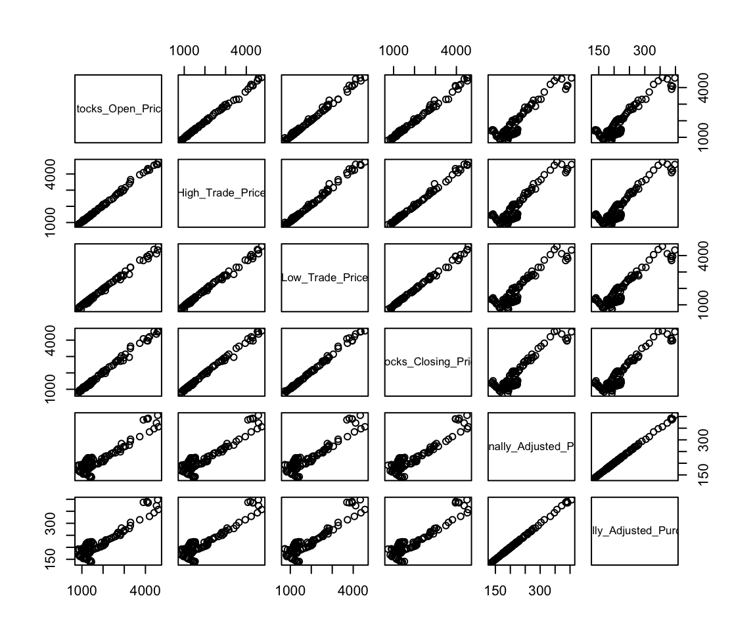
Pairs Plot:
The strong, straight lines in many plots suggest a high correlation between these financial indicators, meaning they tend to move in the same direction.

Slide 7
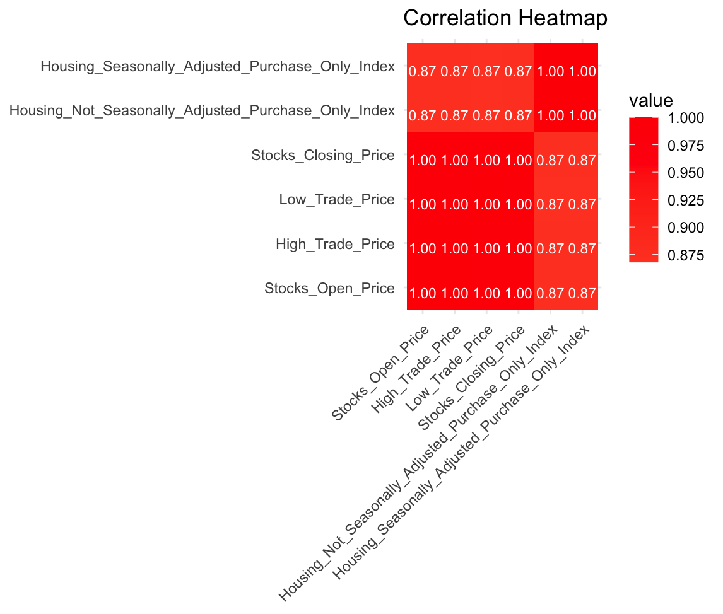
Correlation Matrix:

Slide 8
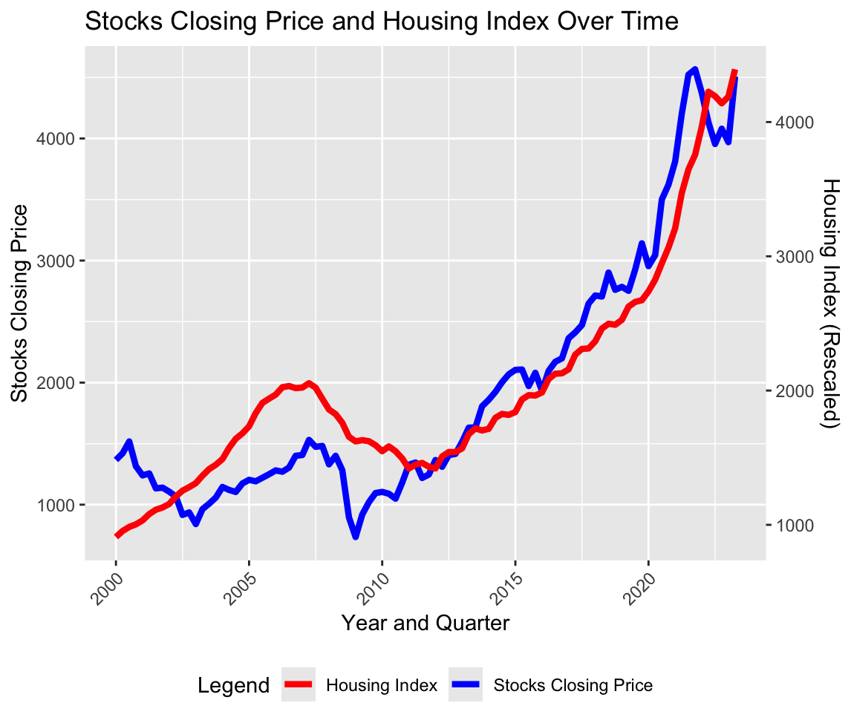
Relationship between Stock and Housing Index
Overall, the plot indicates a positive correlation between the stock's closing price and the housing index, implying that as the stock market rises, the housing index tends to increase as well. This could suggest that a robust stock market, which usually signals a good economy, is concurrent with an uptick in housing market strength, potentially due to increased wealth and investment capacity. Such a relationship might indicate that both markets are influenced by similar economic factors and conditions.

Slide 9

Time Series Analysis

Slide 10
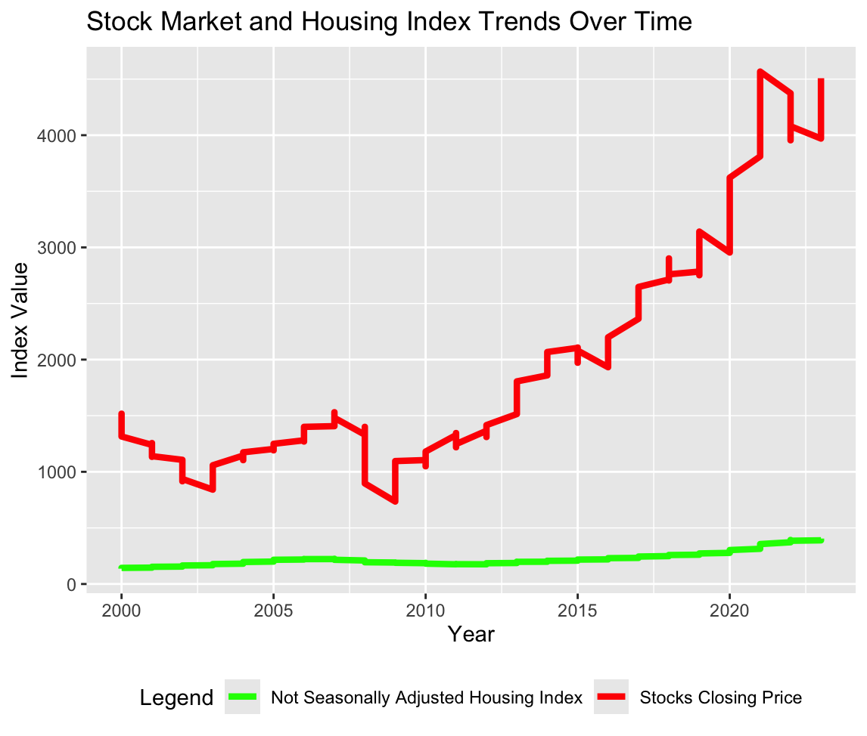
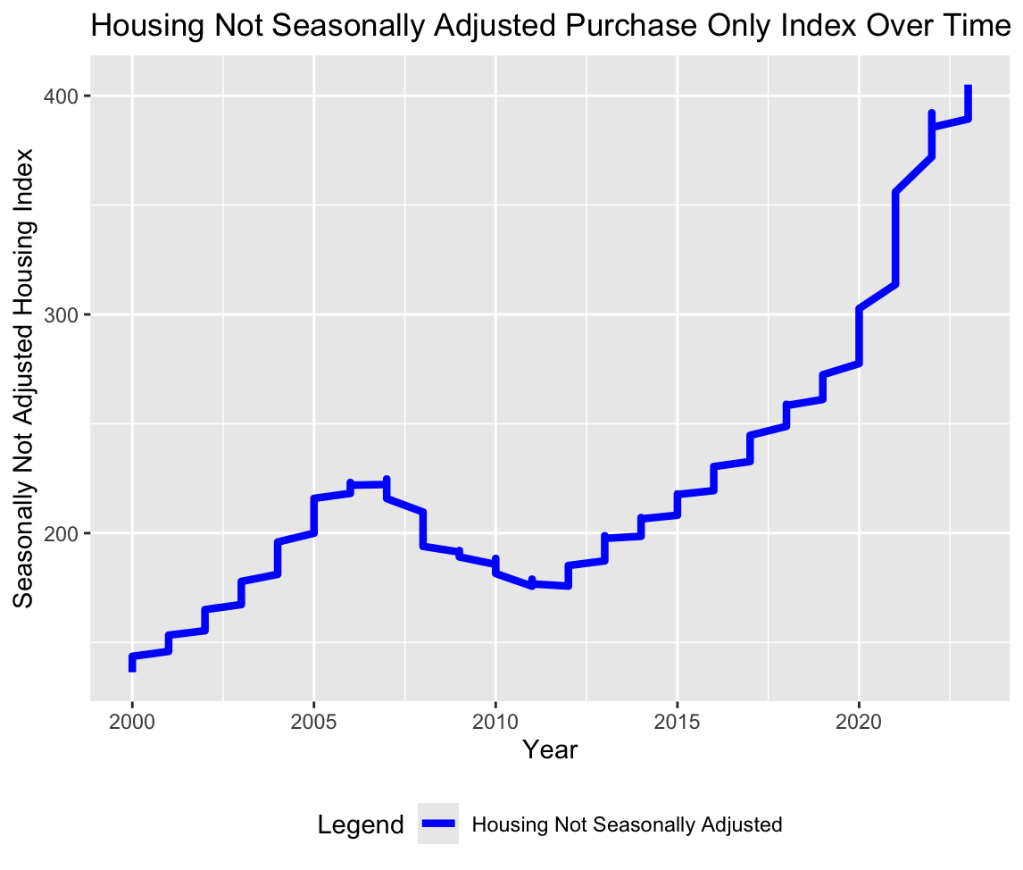
PLOTS OVER TIME:

Slide 11
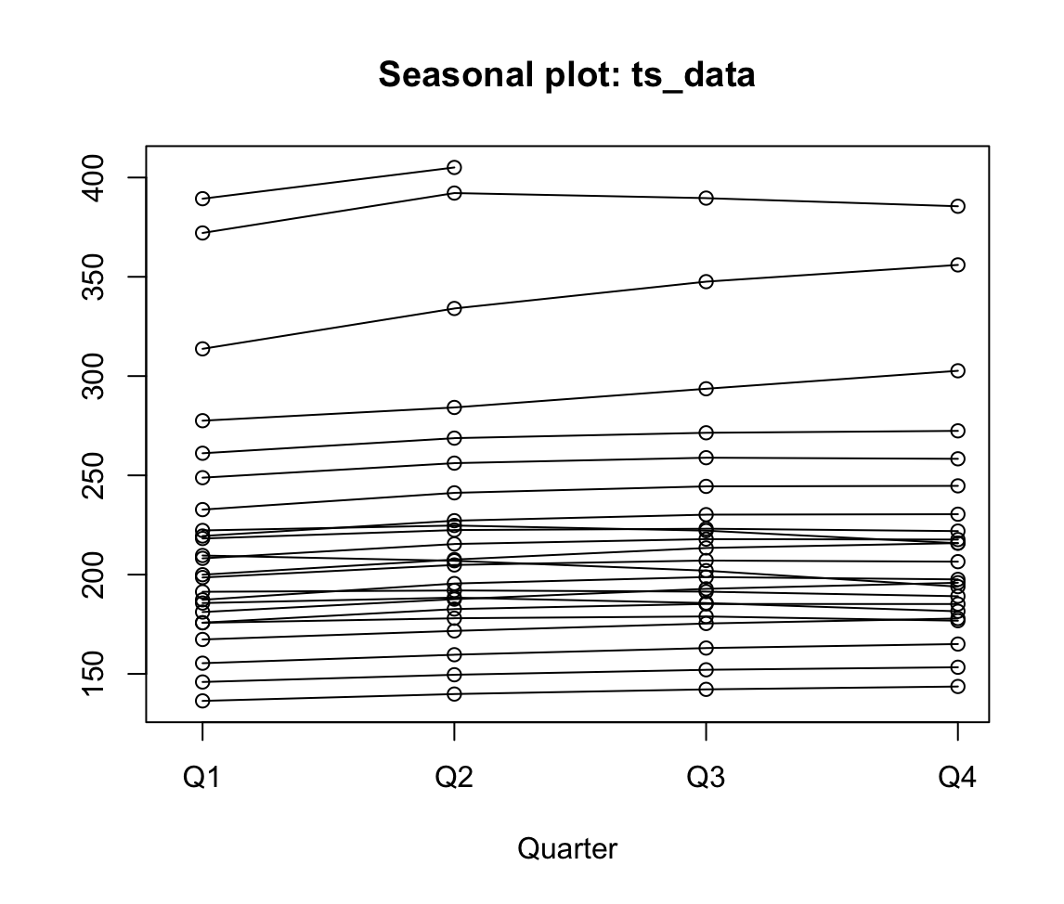
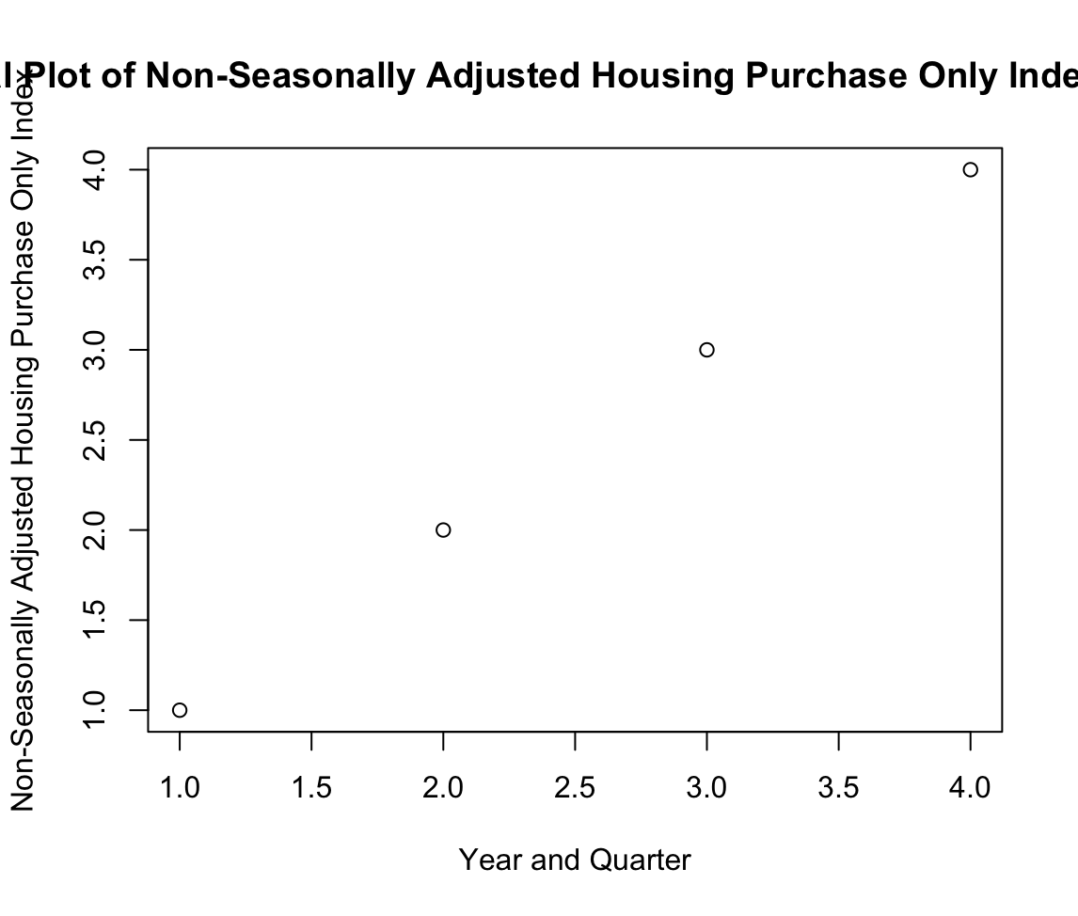
Time Series Object:

Slide 12
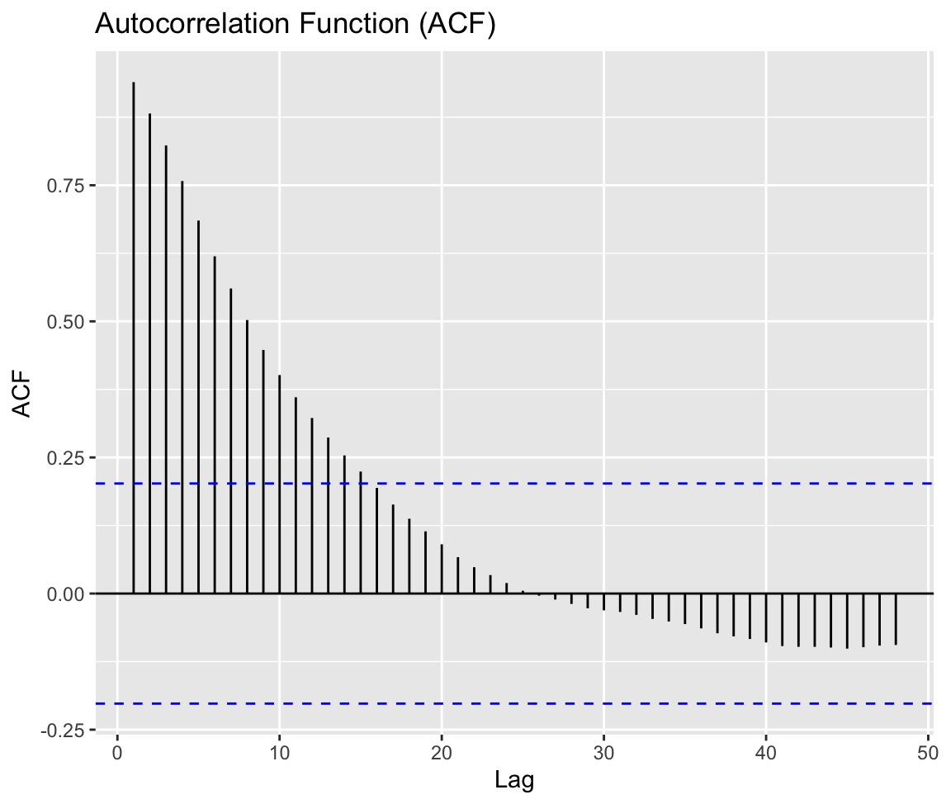
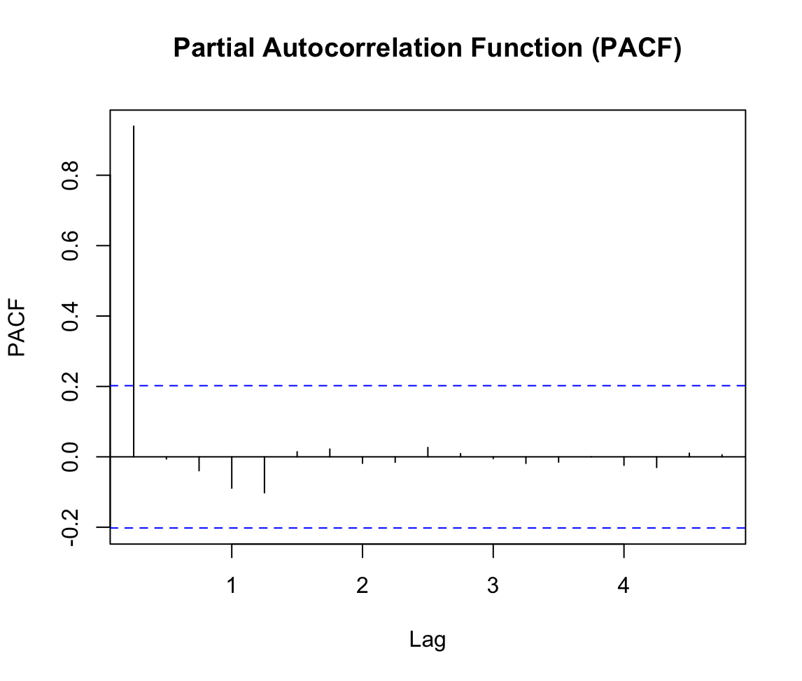
ACF and PACF Plots:

Slide 13
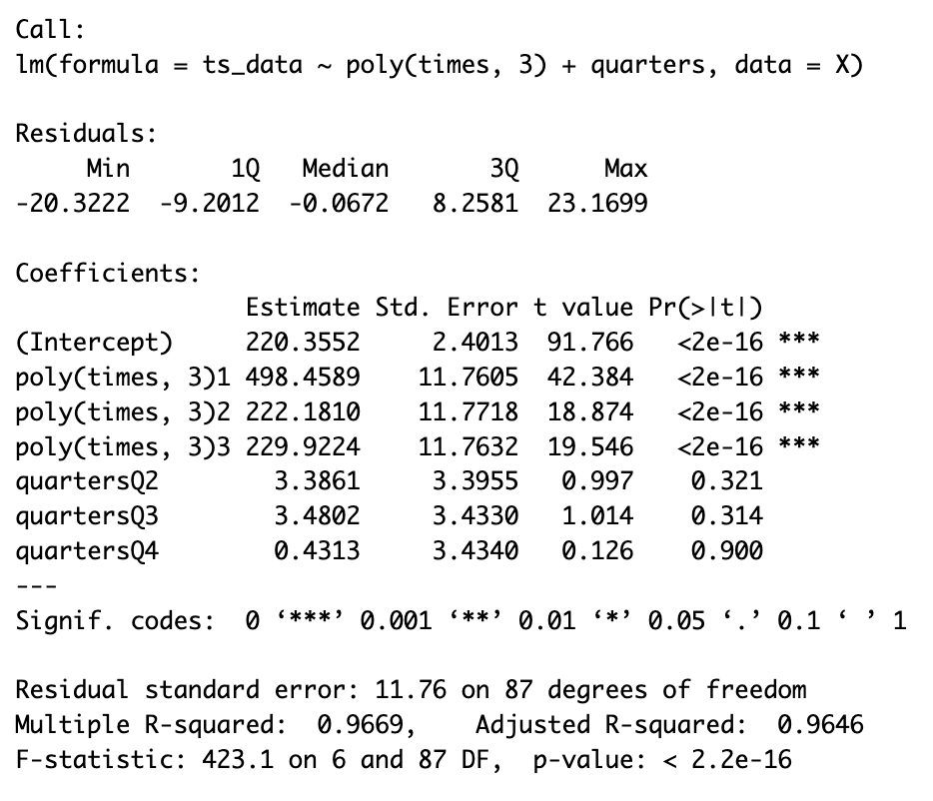
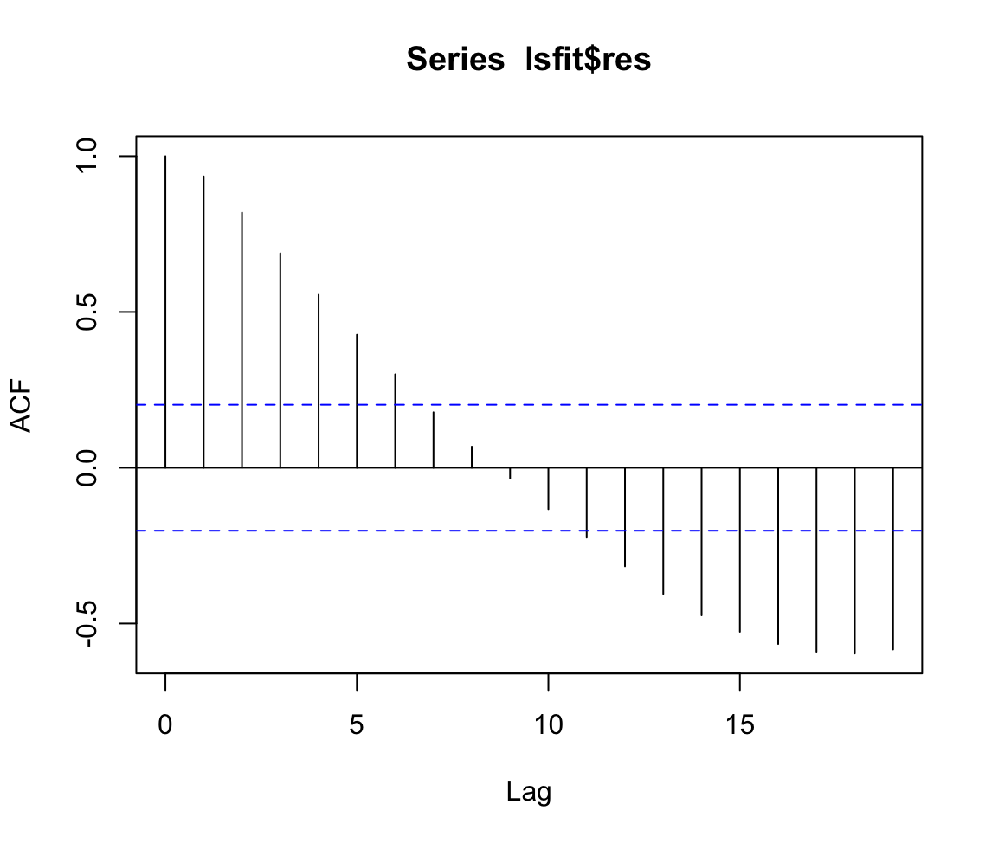
Linear Regression Model:

Slide 14
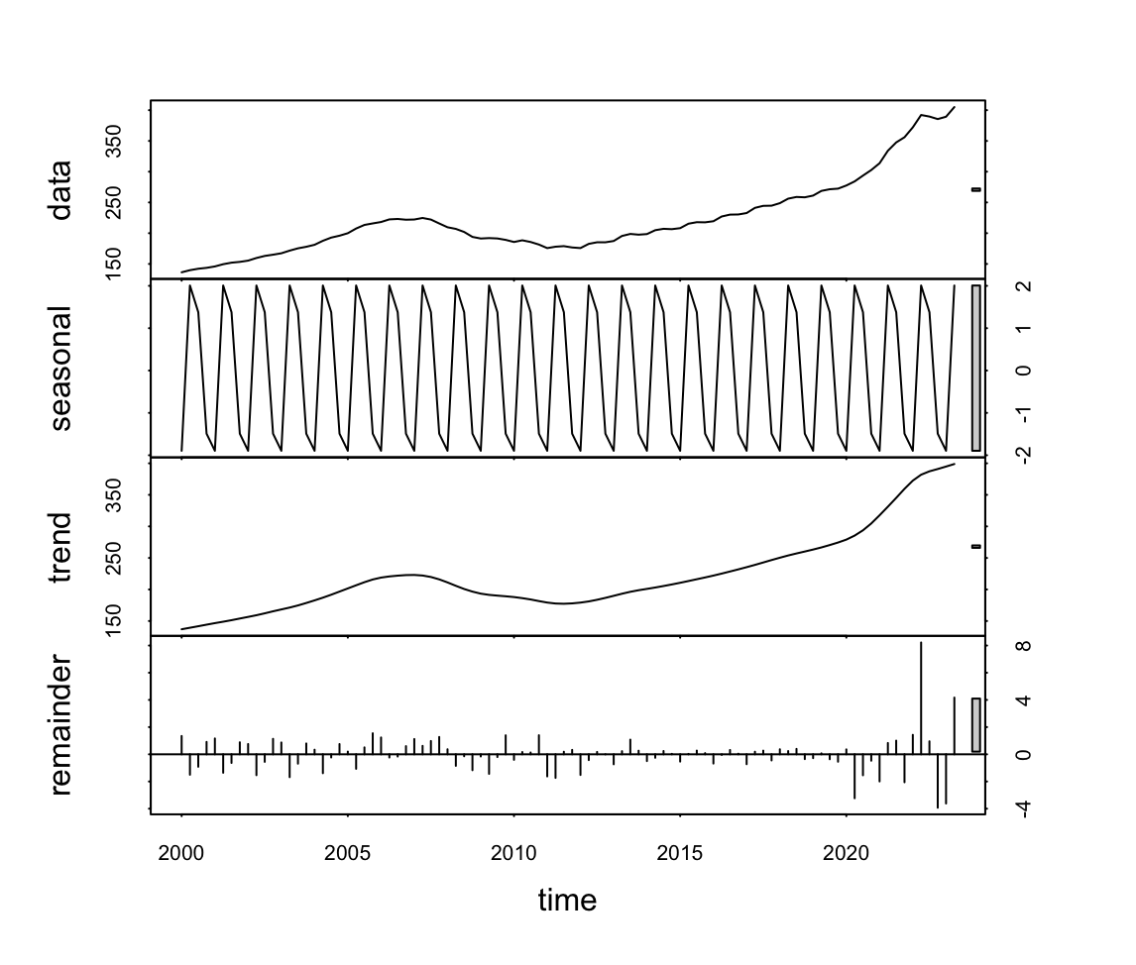
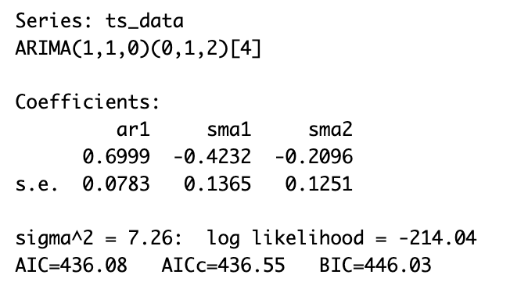
Arima Model:

Slide 15
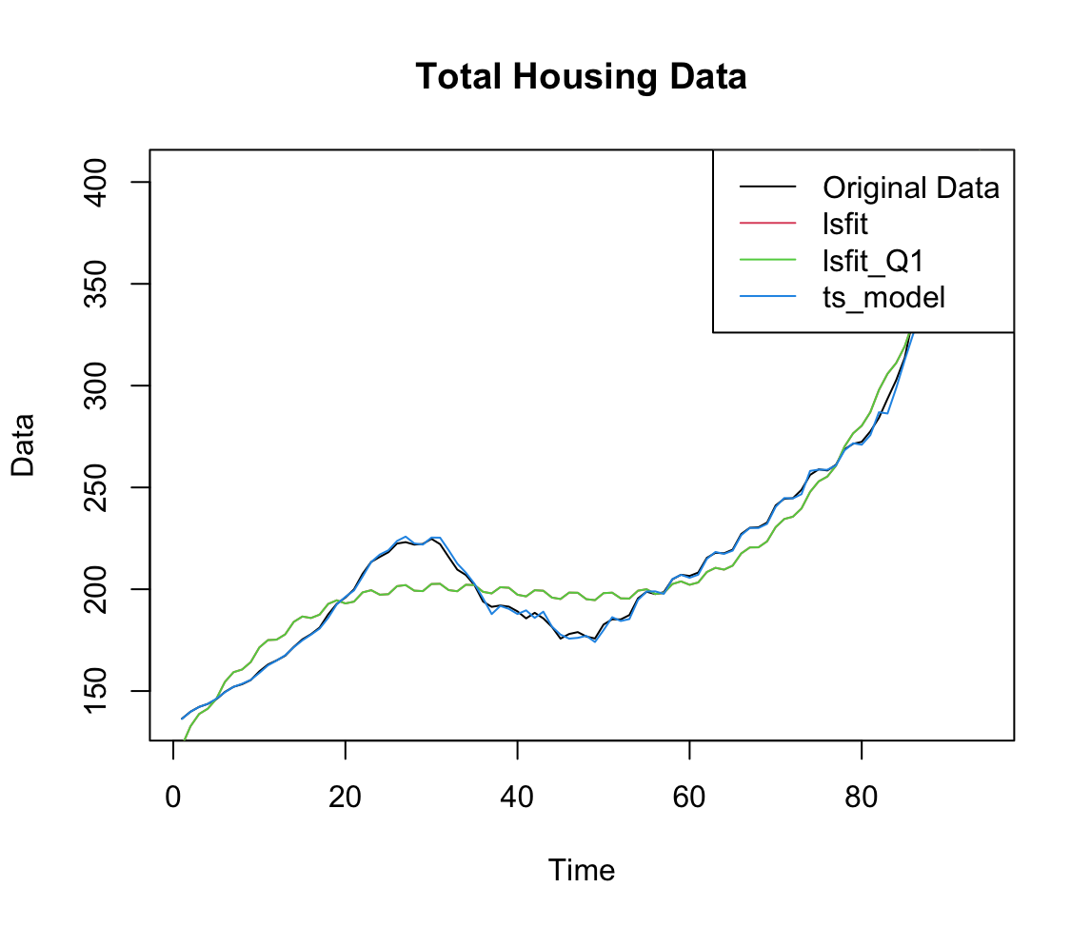
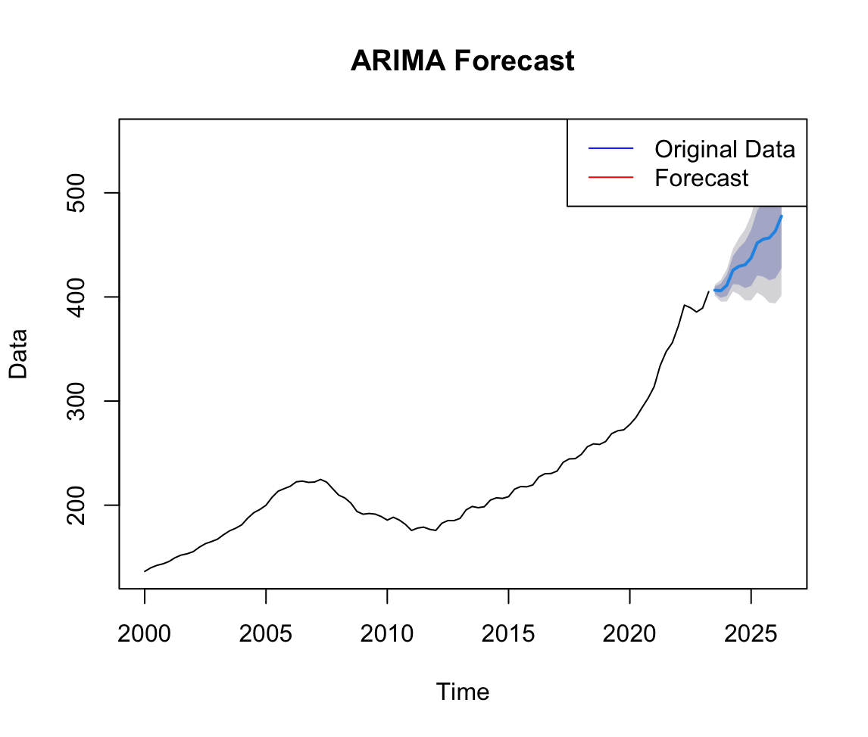
Arima Forecast Plot

Slide 16
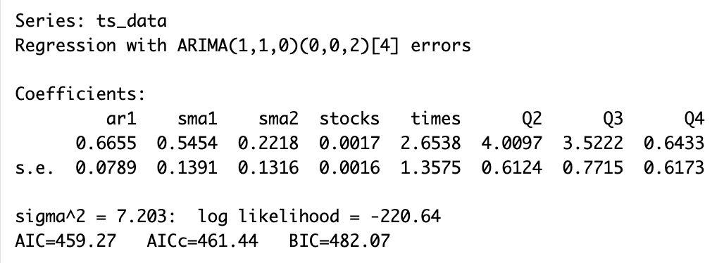
Arima Model with Covariates:

Slide 17

Linear
Regression​

Slide 18
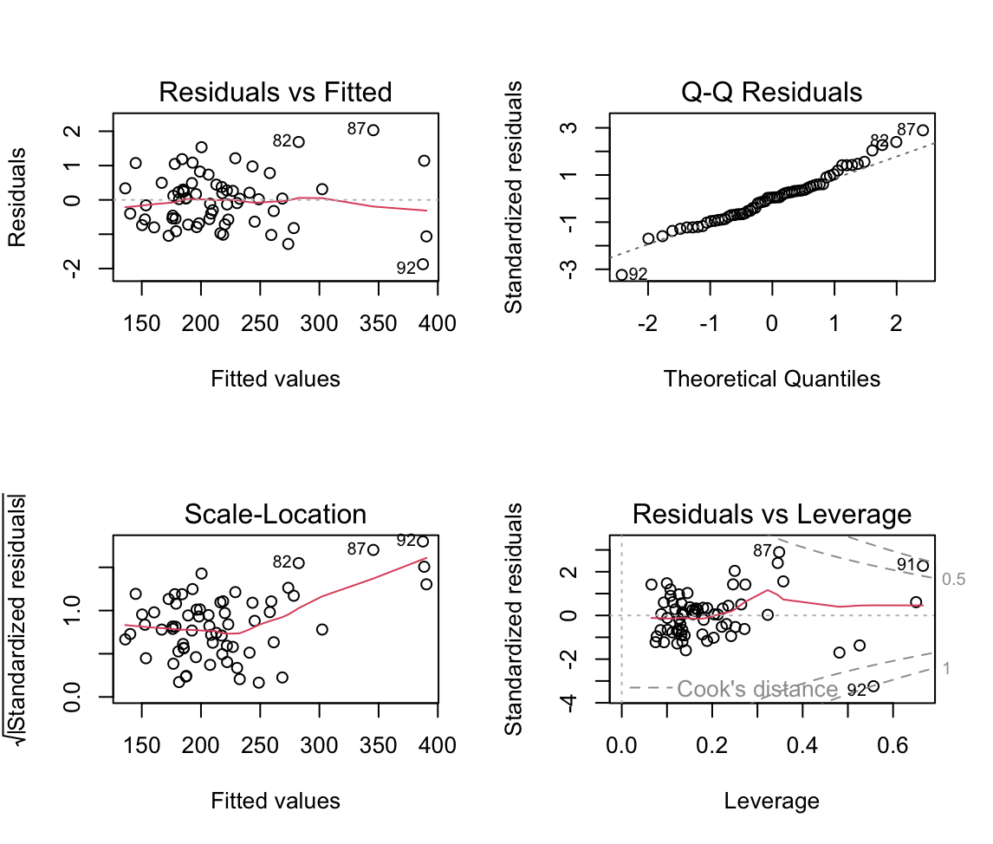
Linear Regression Full Model:
Diagnostic plot of full model. That is Housing Not Seasonally Adjusted Purchase Only Index as the target variable and the remaining variables as predictor variables.​

Slide 19
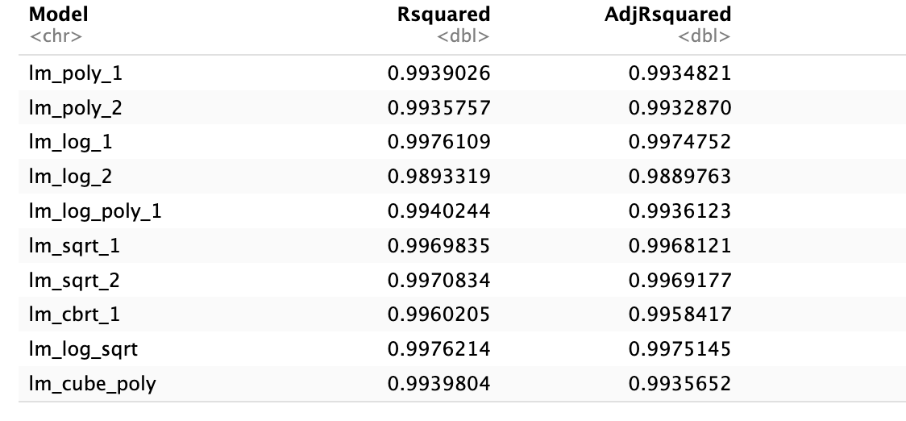
Linear Regression with Interactive Models:
R-Squared values and adjusted R-Squared values of different linear models with transformed variables.

Slide 20
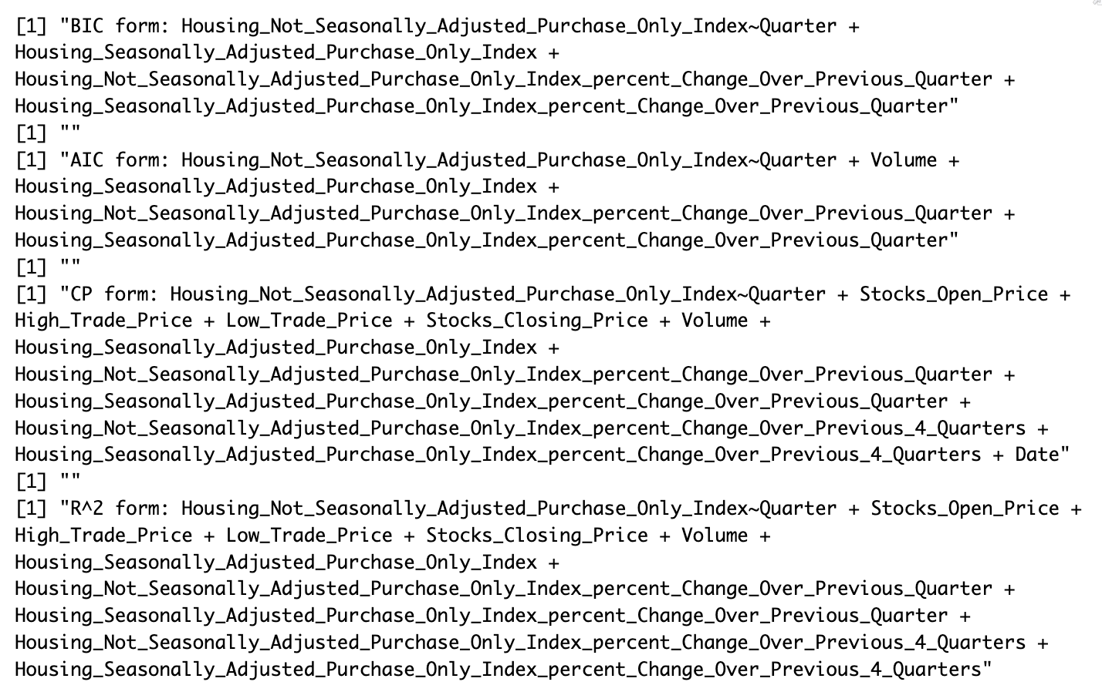
Linear Regression
The models are selected by BIC, AIC, CP, and R2 respectively

Slide 21
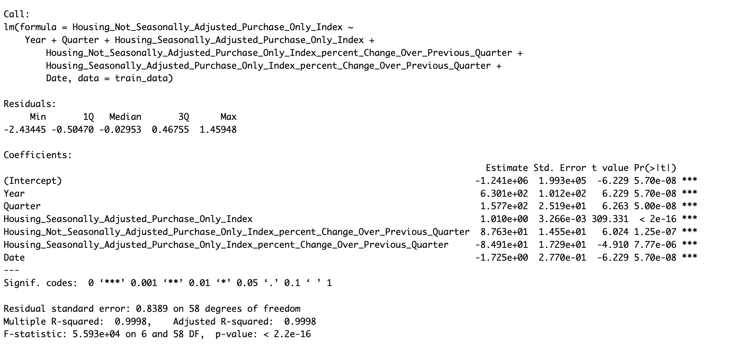
Linear Regression
Summary of Backward Selection Model
Adjusted R2 value – 0.9998

Slide 22
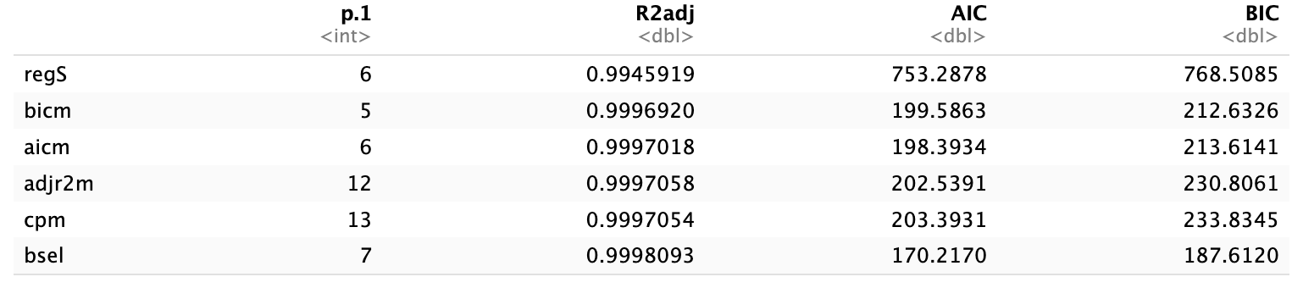
Linear Regression
AIC, BIC, Adjusted R2 and p1 values of reg subset model, BIC model, AIC model, adjusted R2 model, CP model and Backward Selection model
Compared to all models, Backward selection model has high adjusted R2 value and low AIC and BIC values.

Slide 23
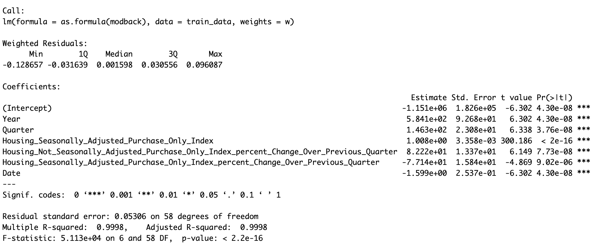
Linear Regression​
Weighted Regression on Backwards Selection model.
Adjusted R2 Value – 0.9998

Slide 24
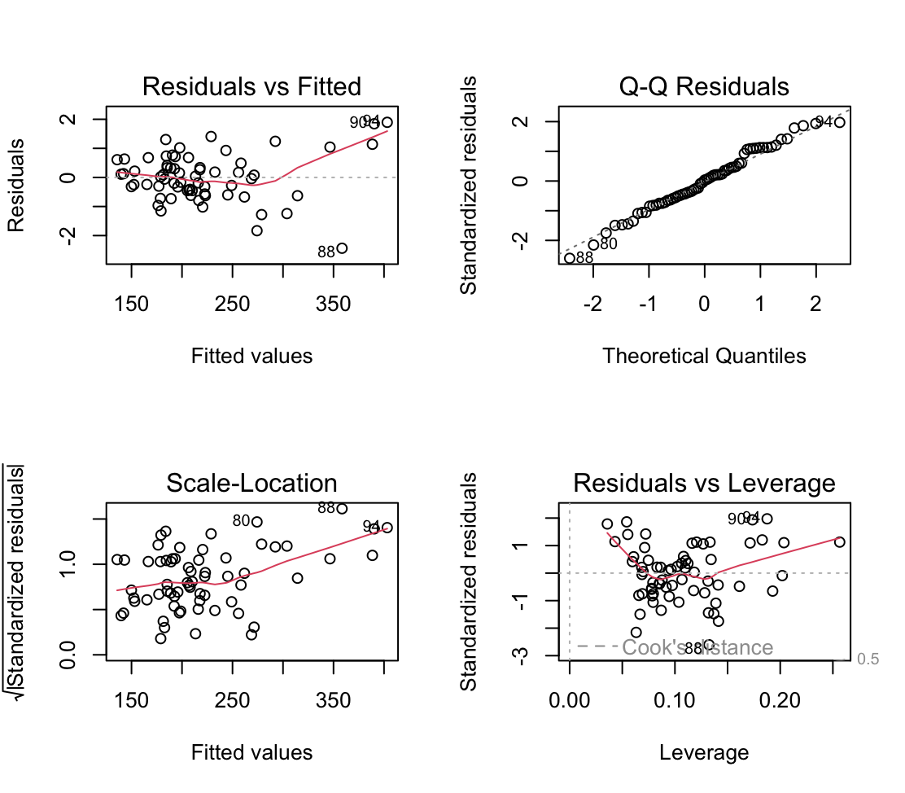
Linear Regression​
Weighted Regression Plot

Slide 25
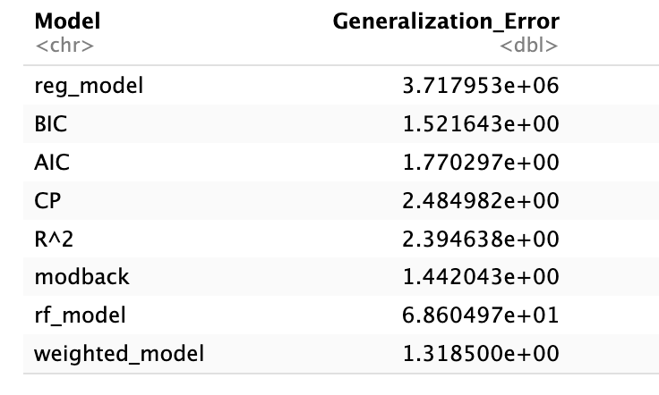
Linear Regression​​
Generalization errors for
different models.
Comparing generalization errors of all the models, we can conclude that backwards model is the best model to accurately predict Housing Not Seasonally Adjusted Purchase Only Index using various economic factors.

Slide 26

Random Forest

Slide 27
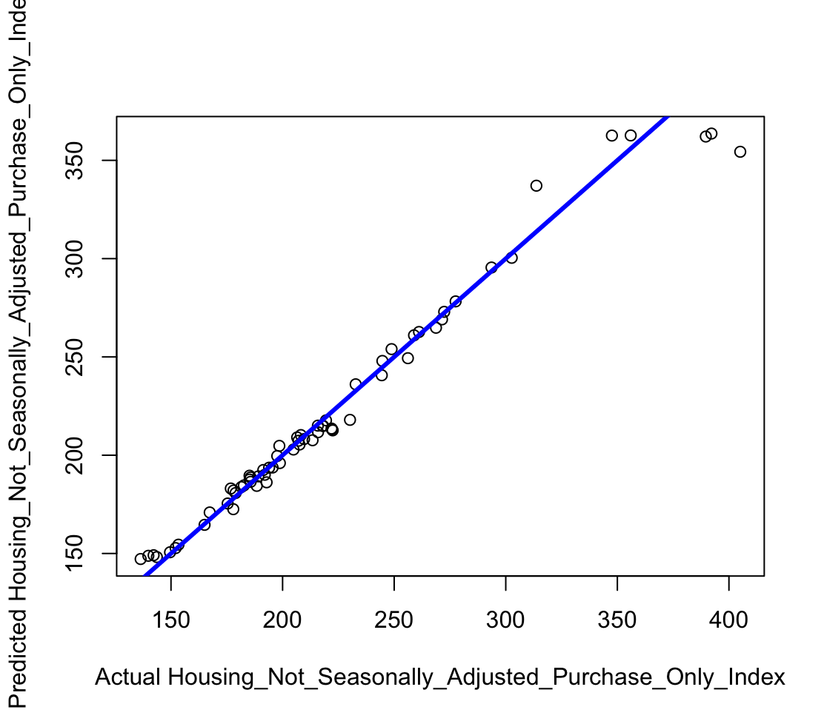
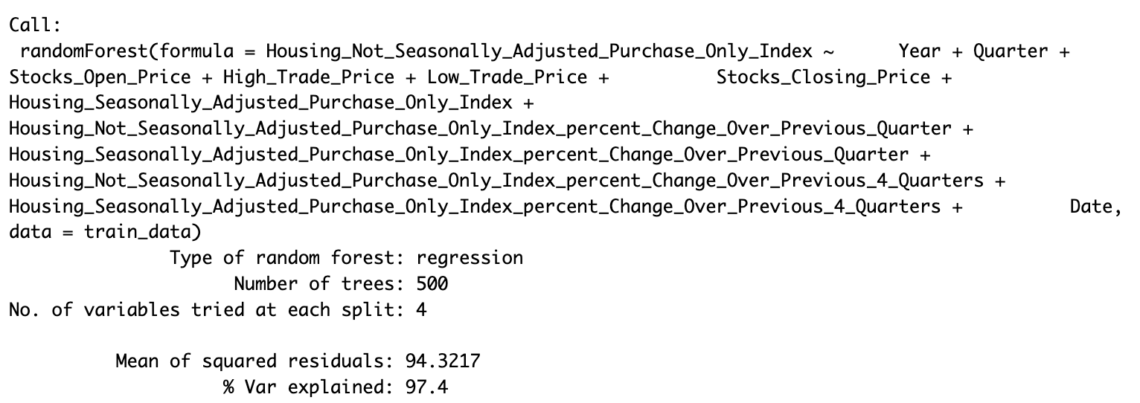
Random Forest
Full Random Forest model with train dataset.
Number of trees: 500
number of variables tried at each split: 4
MSR: 94.3217

Slide 28
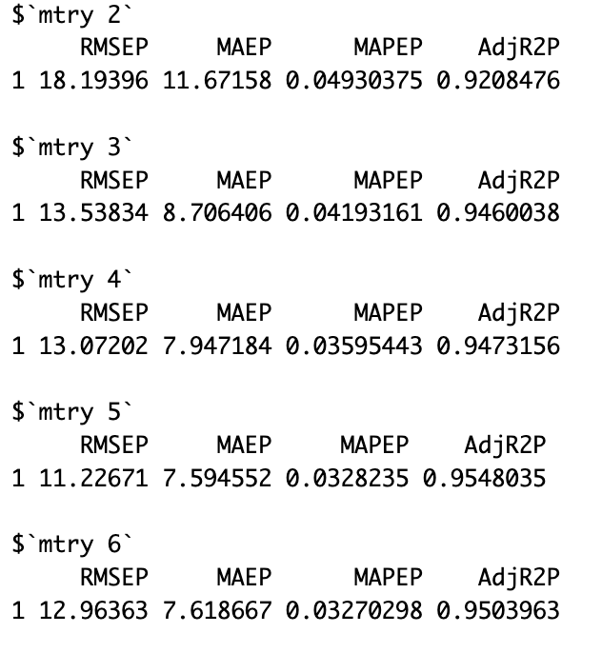
Cross Validation
Performed 5 – fold cross validation by tuning mtry values, starting from 2 to 6

Slide 29
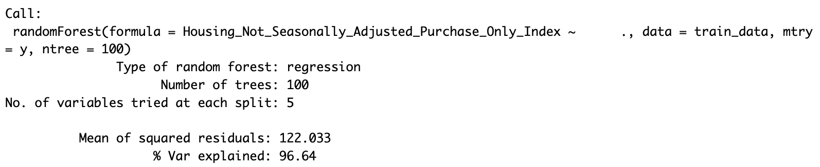
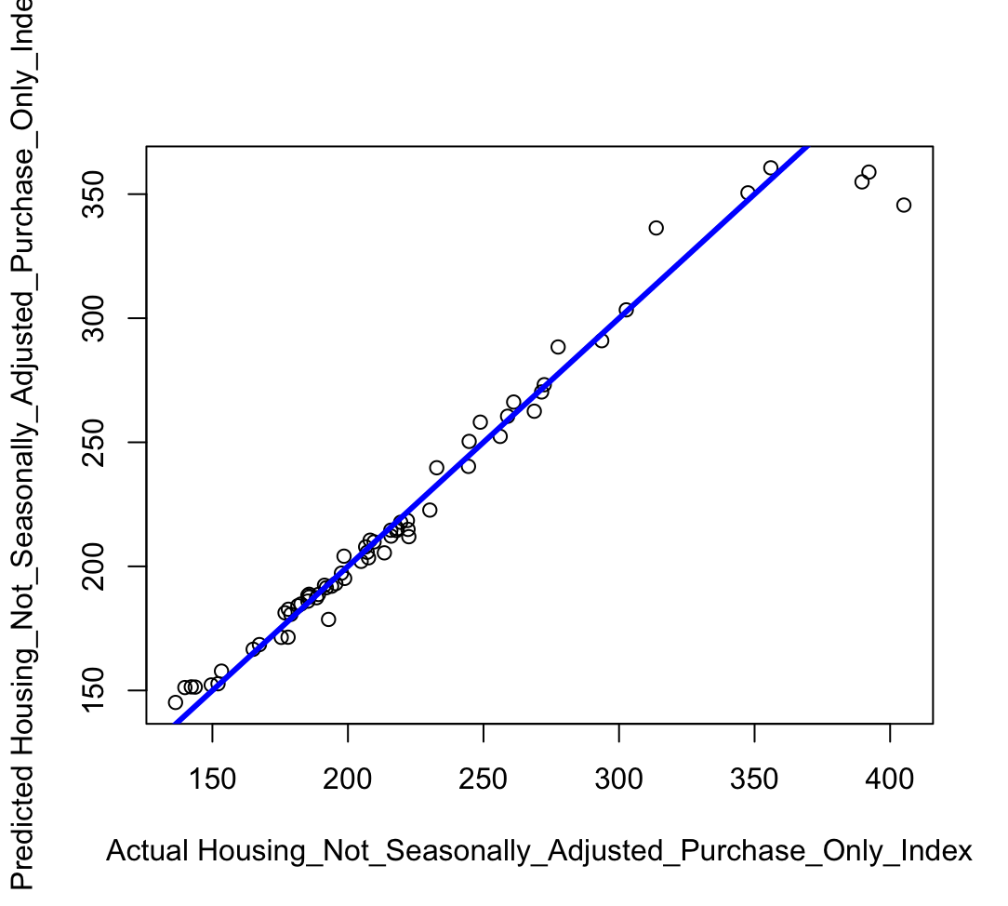
Random Forest for Mtry = 5:
Predicted Housing Not Seasonally Adjusted Purchase Only Index
plot using final random forest model, that is with mtry parameter set to 5.

Slide 30
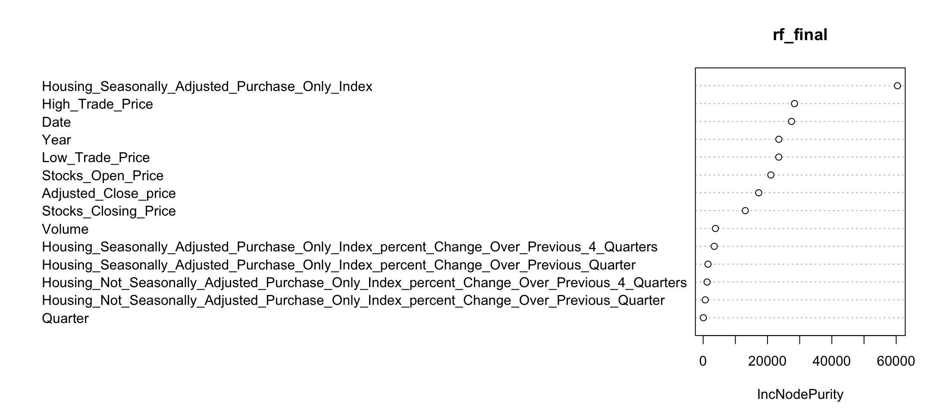
Random Forest

Slide 31
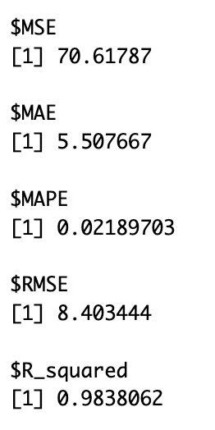
Predicting Housing Not Seasonally Adjusted Purchase Only Index using test data:
Different error metrics values when deployed the final random forest model to predict the Housing Not Seasonally Adjusted Purchase Only Index
in test dataset.
A 0.98 percent R_Squared value tells us that the final Random Forest model with mtry parameter set to 5, was very accurate in predicting Housing Not Seasonally Adjusted Purchase Only Index
when using test dataset.

Slide 32
Conclusion:
The conclusion of this study illustrates a multifaceted relationship between housing rates and various economic indicators. Utilizing Linear Regression and Random Forest models, we've delineated the significant predictors and their intricate interactions with housing prices. The predictive models generated offer valuable foresight into economic trends, providing a data-driven foundation for strategic workforce planning and policy development.

Slide 33

Thank You

